Slide 1
INTRODUCTION TO ALGORITHMS
MANISH PATEL

Slide 2
What is an algorithm?
An algorithm is “a finite set of precise instructions for performing a computation or for solving a problem”
A program is one type of algorithm
All programs are algorithms
Not all algorithms are programs!
Directions to somebody’s house is an algorithm
A recipe for cooking a cake is an algorithm
The steps to compute the cosine of 90° is an algorithm

Slide 3
Some algorithms are harder than others
Some algorithms are easy
Finding the largest (or smallest) value in a list
Finding a specific value in a list
Some algorithms are a bit harder
Sorting a list
Some algorithms are very hard
Finding the shortest path between Miami and Seattle
Some algorithms are essentially impossible
Factoring large composite numbers

Slide 4
Properties of algorithms
Algorithms generally share a set of properties:
Input: what the algorithm takes in as input
Output: what the algorithm produces as output
Definiteness: the steps are defined precisely
Correctness: should produce the correct output
Finiteness: the steps required should be finite
Effectiveness: each step must be able to be performed in a finite amount of time
Generality: the algorithm should be applicable to all problems of a similar form

Slide 5
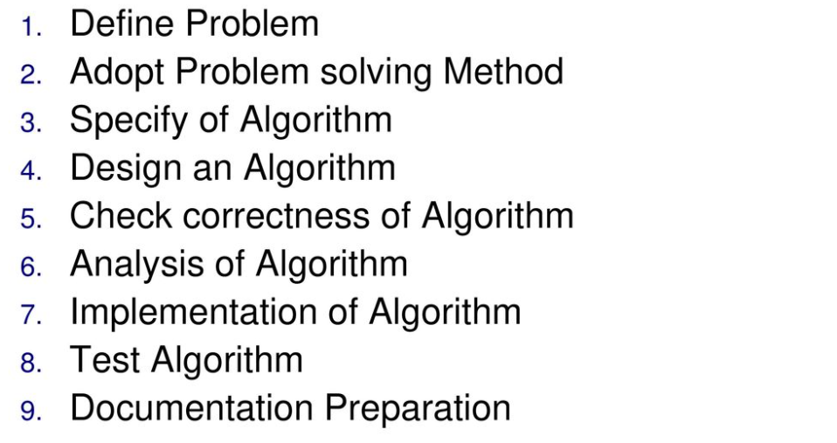
STEPS FOR ALGORITHM DEVELOPMENT

Slide 6
Performance Analysis
Determining an estimate of the time and memory requirement of the algorithm.
Time estimation is called time complexity analysis
Memory size estimation is called space complexity analysis.
Because memory is cheap and abundant, we rarely do space complexity analysis
Since time is “expensive” , analysis now defaults to time complexity analysis

Slide 7
Asymptotic Analysis
Asymptotic analysis looks at the order of the running time of the algorithm
A valuable tool when the input gets “large”
Ignores the effects of different machines or different implementations of an algorithm
Intuitively, to find the asymptotic runtime, throw away the constants and low-order terms
Linear search is T(n) = 3n + 2 ∈ O(n)
Binary search is T(n) = 4 log2n + 4 ∈ O(log n)
Bases don’t matter, more in a sec
Remember: the fastest algorithm has the slowest growing function for its runtime
Notes:
Okay, so the point of all those pretty pictures is to show that, while constants matter, they don’t really matter as much as the order for “sufficiently large” input (“large” depends, of course, on the constants).

Slide 8
Asymptotic Analysis
4n
0.5 n log n
2^n
---
n
n log n
= 2 n log n
= n log n
Eliminate low order terms
4n + 5 ⇒
0.5 n log n + 2n + 7 ⇒
Eliminate coefficients
4n ⇒
0.5 n log n ⇒
Any base x log is equivalent to a base 2 log within a constant factor
log_A B = log_x B ------------- log_x A
log_x B = log_2 B ------------- log_2 x
Notes:
We didn’t get very precise in our analysis of the UWID info finder; why?
Didn’t know the machine we’d use.
Is this always true? Do you buy that coefficients and low order terms don’t matter?
When might they matter?
(Linked list memory usage)

Slide 9
Time Complexity is categorized into three types:
Best Case Running Time–
The performance of the algorithm is best under optimal conditions. For example, the best case for a binary search occurs when the desired element is the middle element of the list. Another example is that of sorting; that is, if the elements are already sorted in a list, then the algorithm will execute in the best time.
Average Case Running Time–
This denotes the behavior of an algorithm when the input is randomly drawn from a given collection or distribution. It is an estimate of the running time for “average” input. It is usually assumed that all inputs of a given size are likely to occur with equal probability.
Worst Case Running Time–
The behavior of the algorithm during the worst possible case of the input instance. The worst case running time of an algorithm is an upper bound on the running time for any input. For example, the worst case for a linear search occurs when the desired element is the last element in the list or the element does not exist in the list.

Slide 10
Big-O Notation
Let n be a non-negative integer representing the size of the input to an algorithm
Let f(n) and g(n) be two positive functions, representing the number of basic calculations (operations, instructions) that an algorithm takes (or the number of memory words an algorithm needs).
Big-O notation represents the upper bound of the running time of an algorithm. Thus, it gives the worst-case complexity of an algorithm.

Slide 11
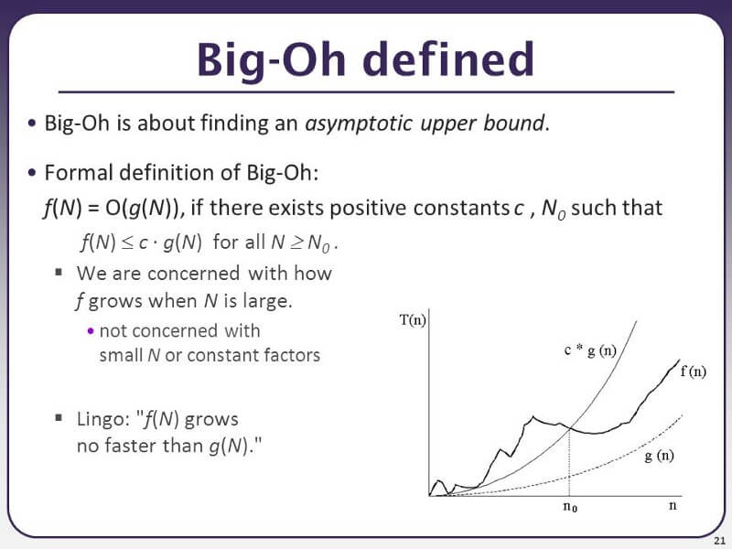
Big-O Notation (contd.)
f(n)=O(g(n)) iff there exist a positive constant C and non-negative integer n₀ such that
f(n) ≤ Cg(n) for all n≥n0.
g(n) is said to be an upper bound of f(n).

Slide 12
Big-O Notation (Examples)
f(n) = 5n+2 = O(n) // g(n) = n
f(n) ≤ 6n, for n ≥ 3 (C=6, n₀=3)
f(n)=n/2 –3 = O(n)
f(n) ≤ 0.5 n for n ≥ 0 (C=0.5, n₀=0)
n²-n = O(n²) // g(n) = n²
n²-n ≤ n² for n ≥ 0 (C=1, n₀=0)
n(n+1)/2 = O(n²)
n(n+1)/2 ≤ n² for n ≥ 0 (C=1, n₀=0)

Slide 13
Big-O: Common Names
constant: O(1)
logarithmic: O(log n) (log_{k}n, log n² ∈ O(log n))
linear: O(n)
log-linear: O(n log n)
quadratic: O(n²)
cubic: O(n³)
polynomial: O(n^{k}) (k is a constant)
exponential: O(c^{n}) (c is a constant > 1)

Slide 14
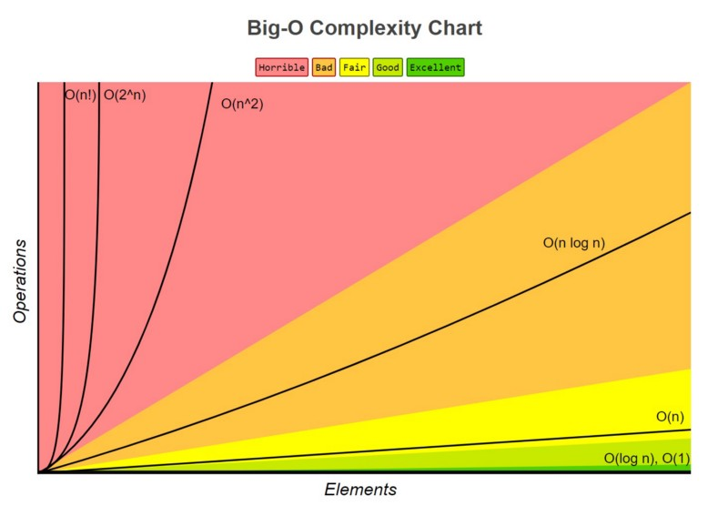

Slide 15
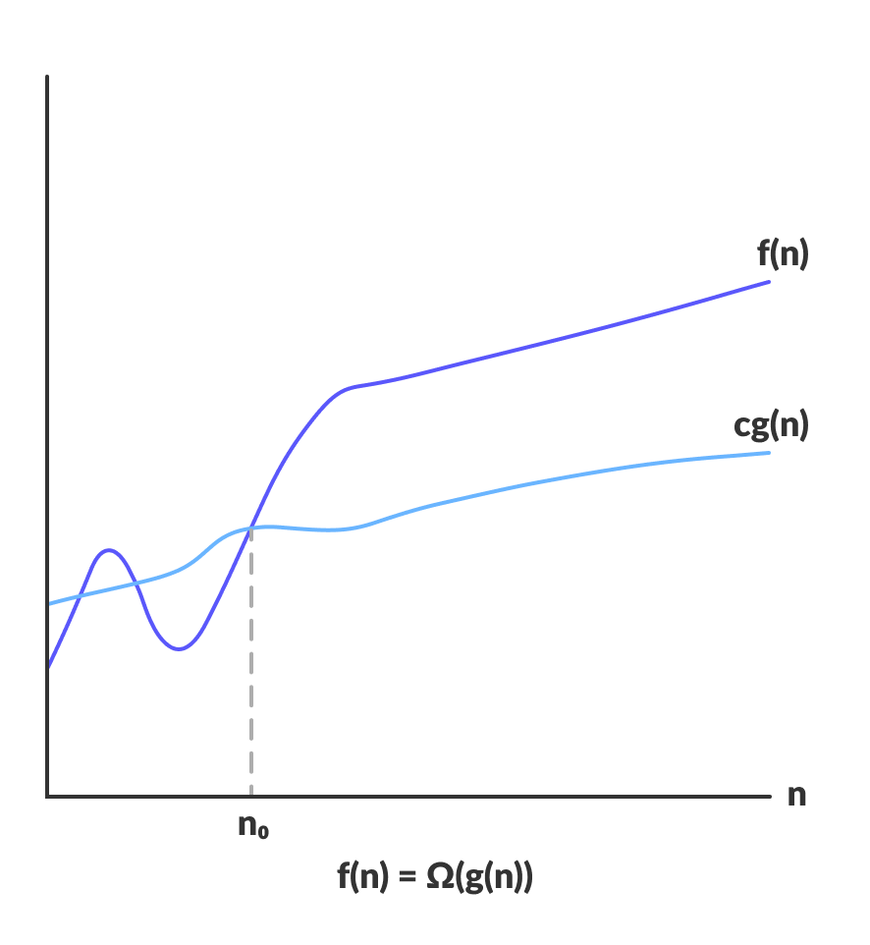
Omega Notation (Ω-notation)
Omega notation represents the lower bound of the running time of an algorithm. Thus, it provides the best case complexity of an algorithm.

Slide 16
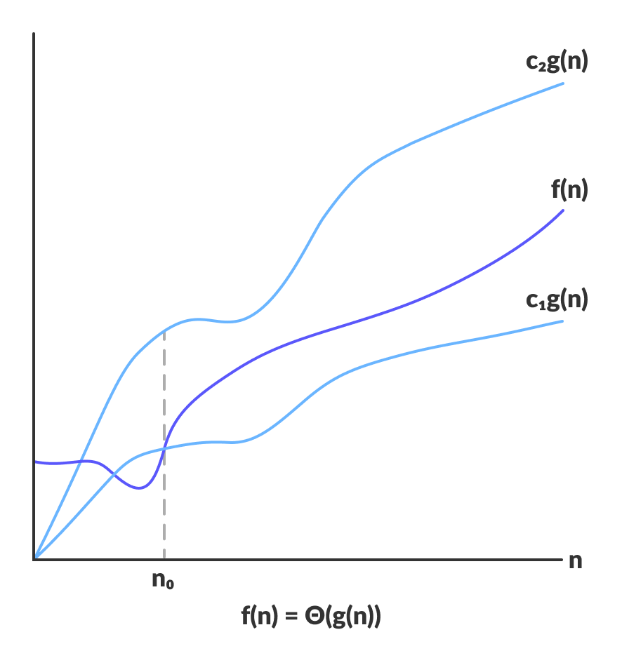
Theta Notation (Θ-notation)
Theta notation encloses the function from above and below. Since it represents the upper and the lower bound of the running time of an algorithm, it is used for analyzing the average-case complexity of an algorithm.

Slide 17
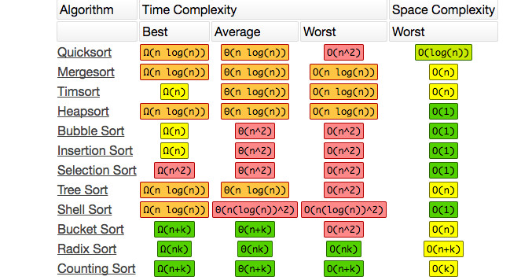

Slide 18
